Slide 1
Wolter Optics in 2 parts
McStas Wolter optics from the X-ray telescope community
McStas Wolter optics from neutron scatterers at MIT

Slide 2
Astronomical Wolter Telescopes
Simulation capabilities AstroX/McXtrace and McStas

Slide 3
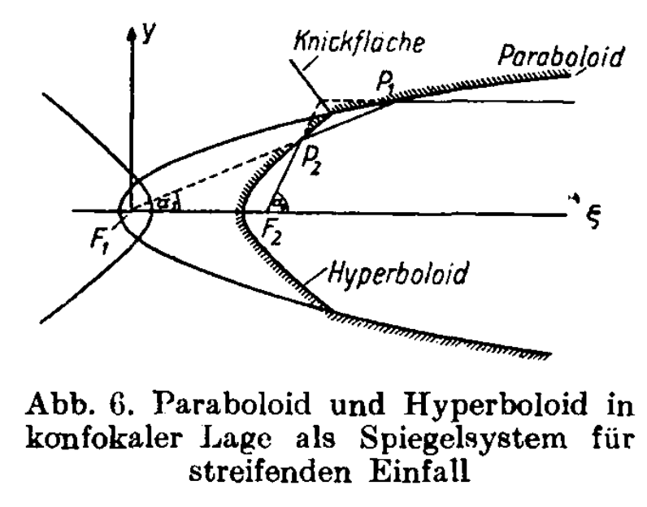
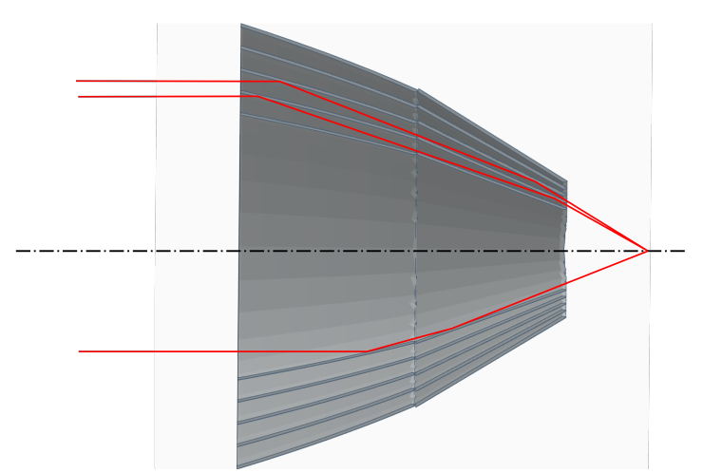
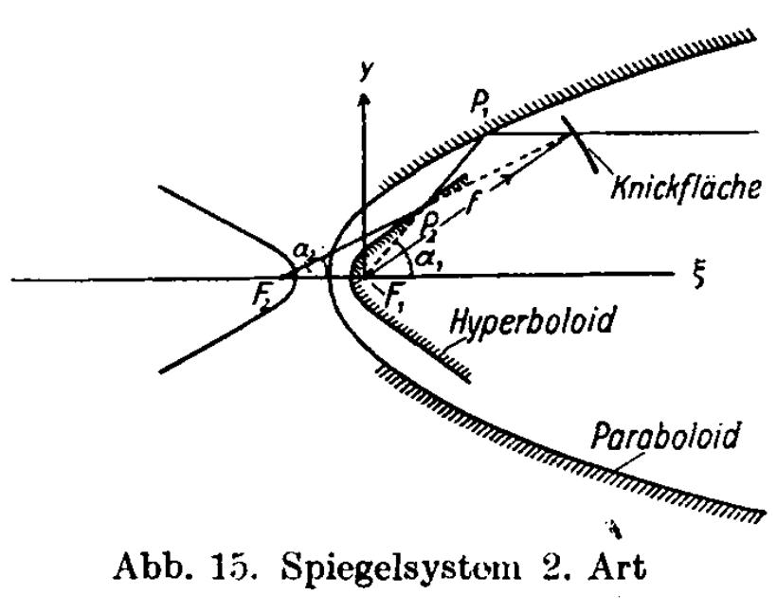
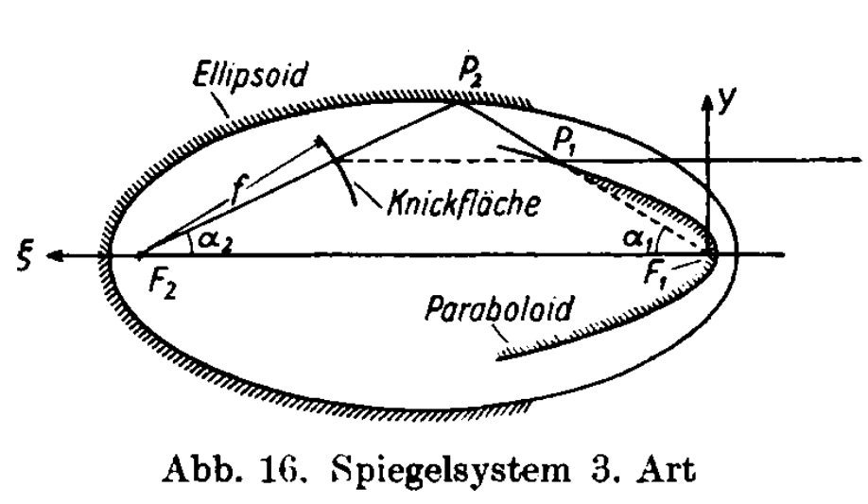
Astro-Wolter Optic Variants
Wolter type I
True Wolter-I:
Parabolic+Hyperbolic
Conical approximation:
Linear Conic x 2
Wide field optics: Hyperboloid-Hyperboloid:
Wolter type II
Wolter type III
Imaging:
Elliptic Hyperboloid:
Etc...

Slide 4
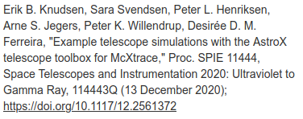
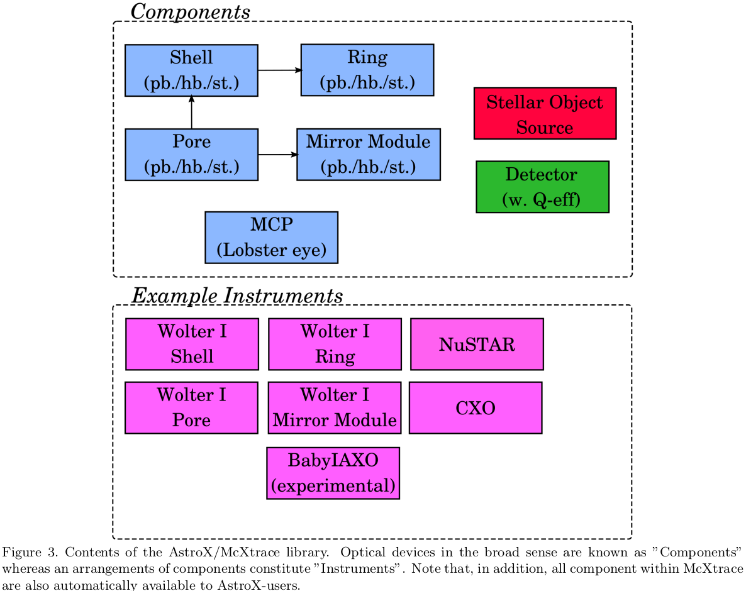
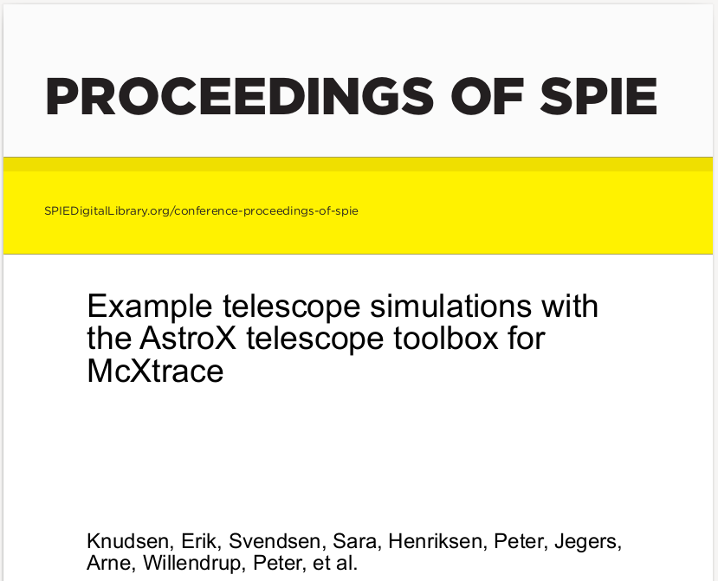
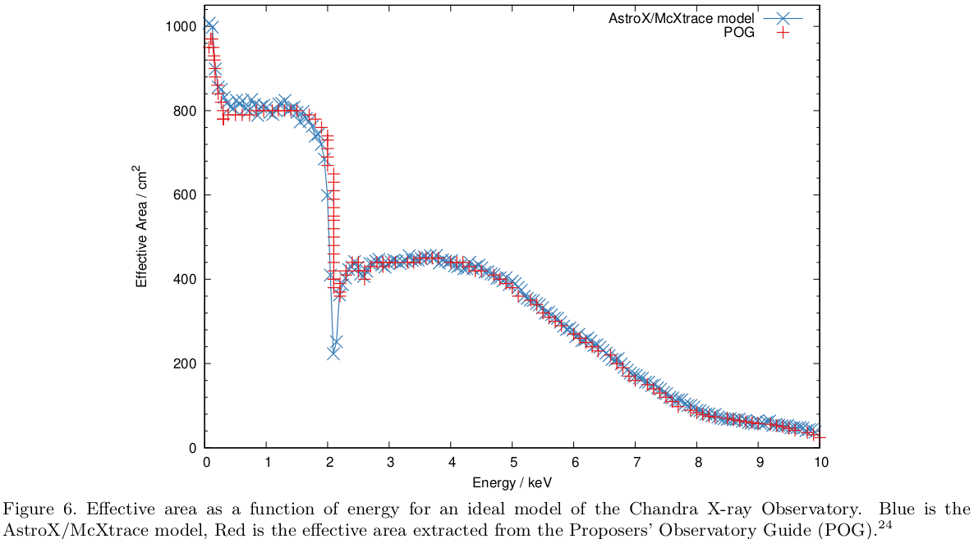
AstroX – addon toolbox for McXtrace
Set of components concept orignally based on Silicon Pore Optics (SPOs). A tech for creating lightweight but stiff large area Wolter Optics.

Slide 5
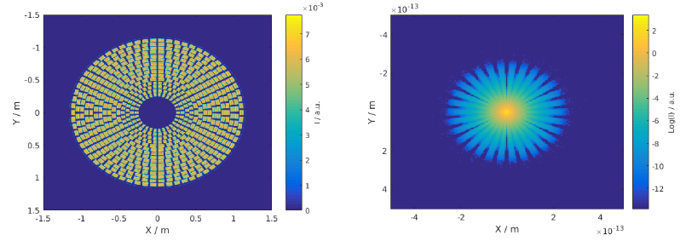
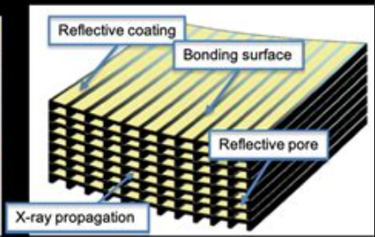
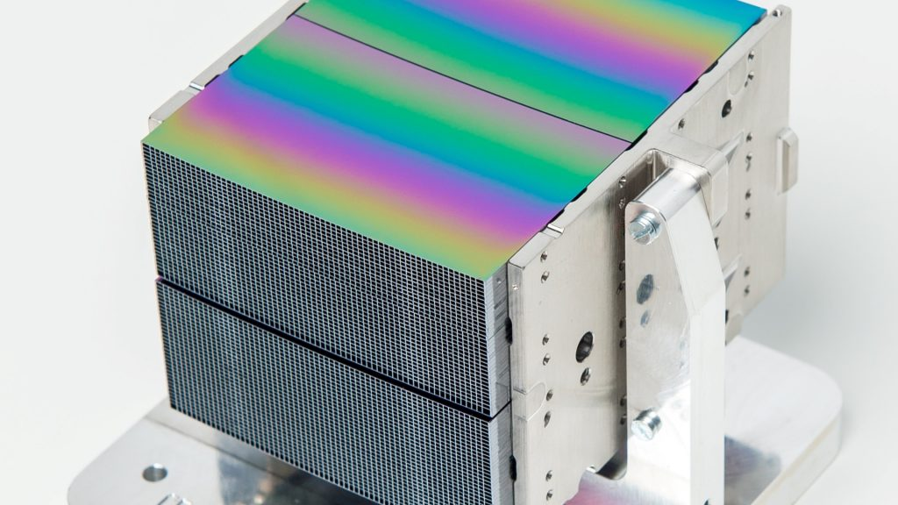
Silicon Pore Optics/Mirror Modules
ATHENA simulation

Slide 6
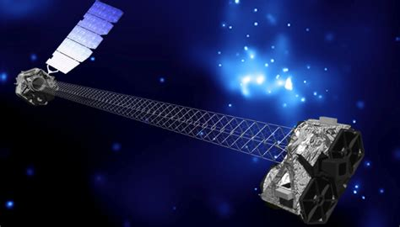
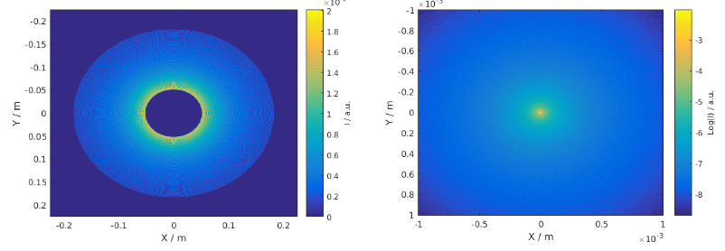
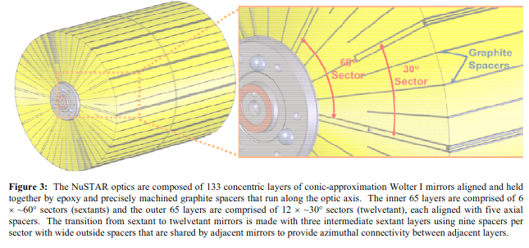
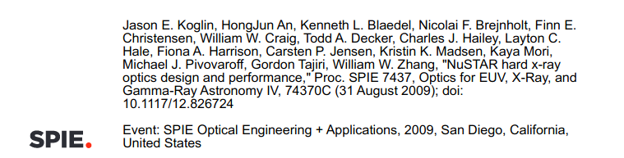
Conical Approximation /NuSTAR
NuSTAR conic approximation

Slide 7
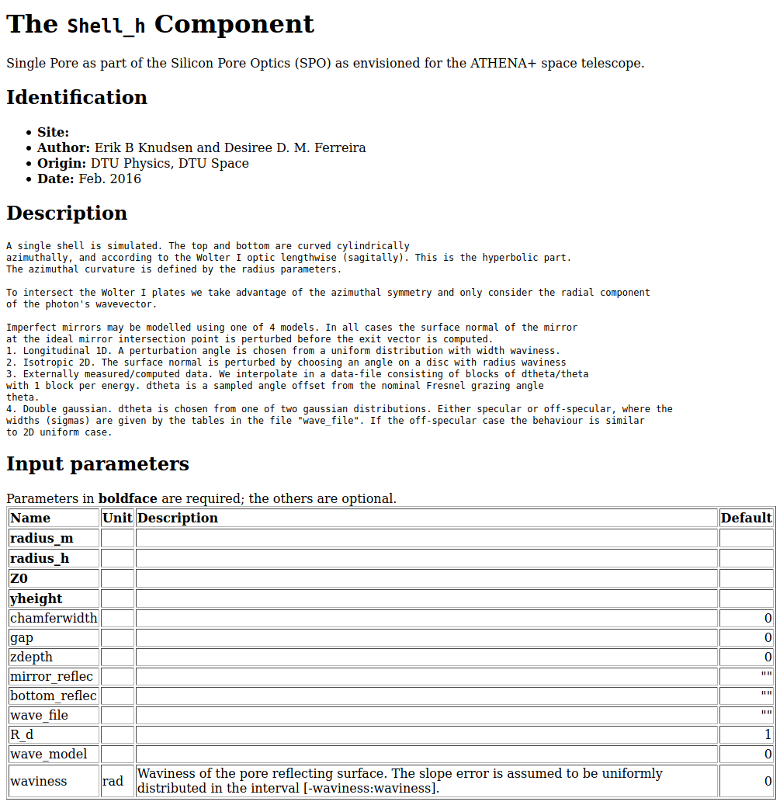
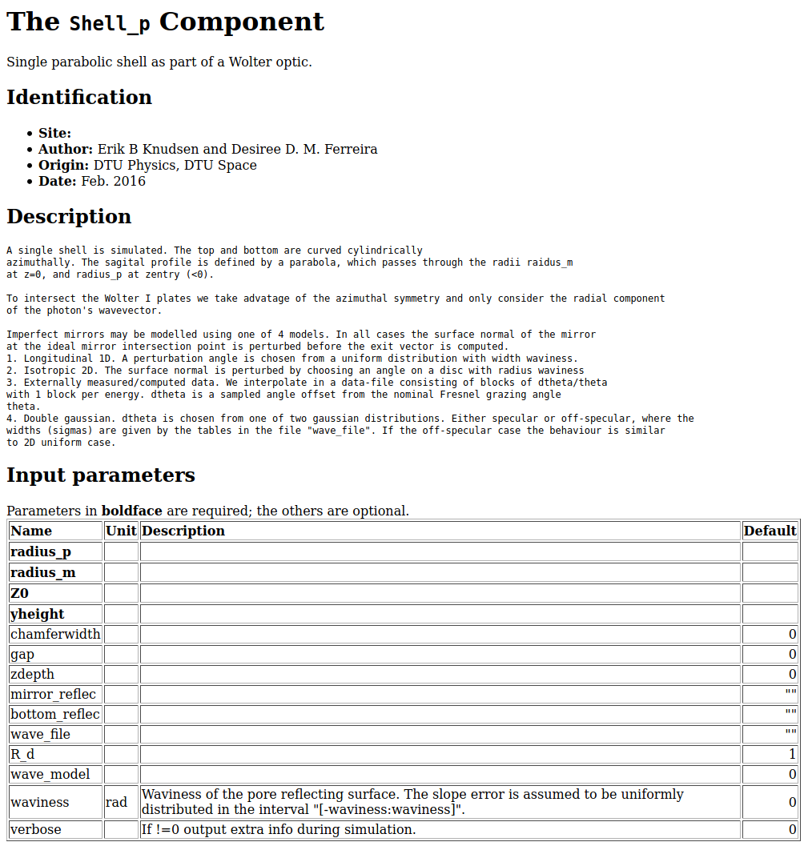
Parabolic Shell
Hyperbolic Shell

Slide 8
Code Structure
Self-contained "regular" McStas/McXtrace component. Similar to guide.
Mirrors may have side walls and/or bottom surface. Both may be reflective.
Intended for use in a GROUP
Need a pair of components to form an optic.
In the case of ATHENA: 2 x 678 components. =>
Mirror by Mirror = 16000
Models for waviness/mirror imperfections included.

Slide 9
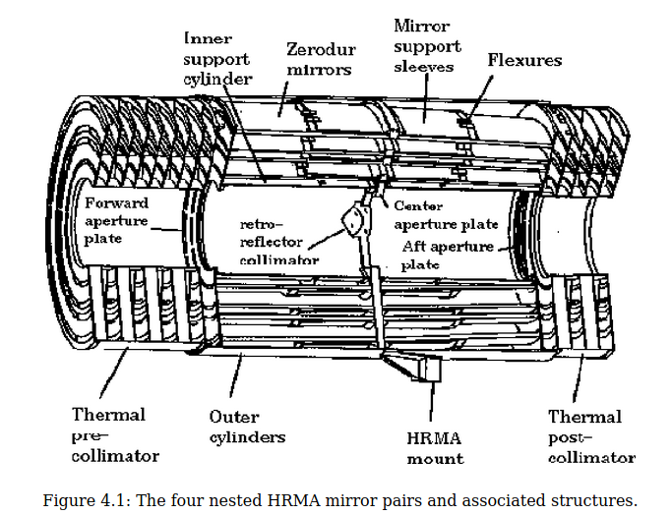
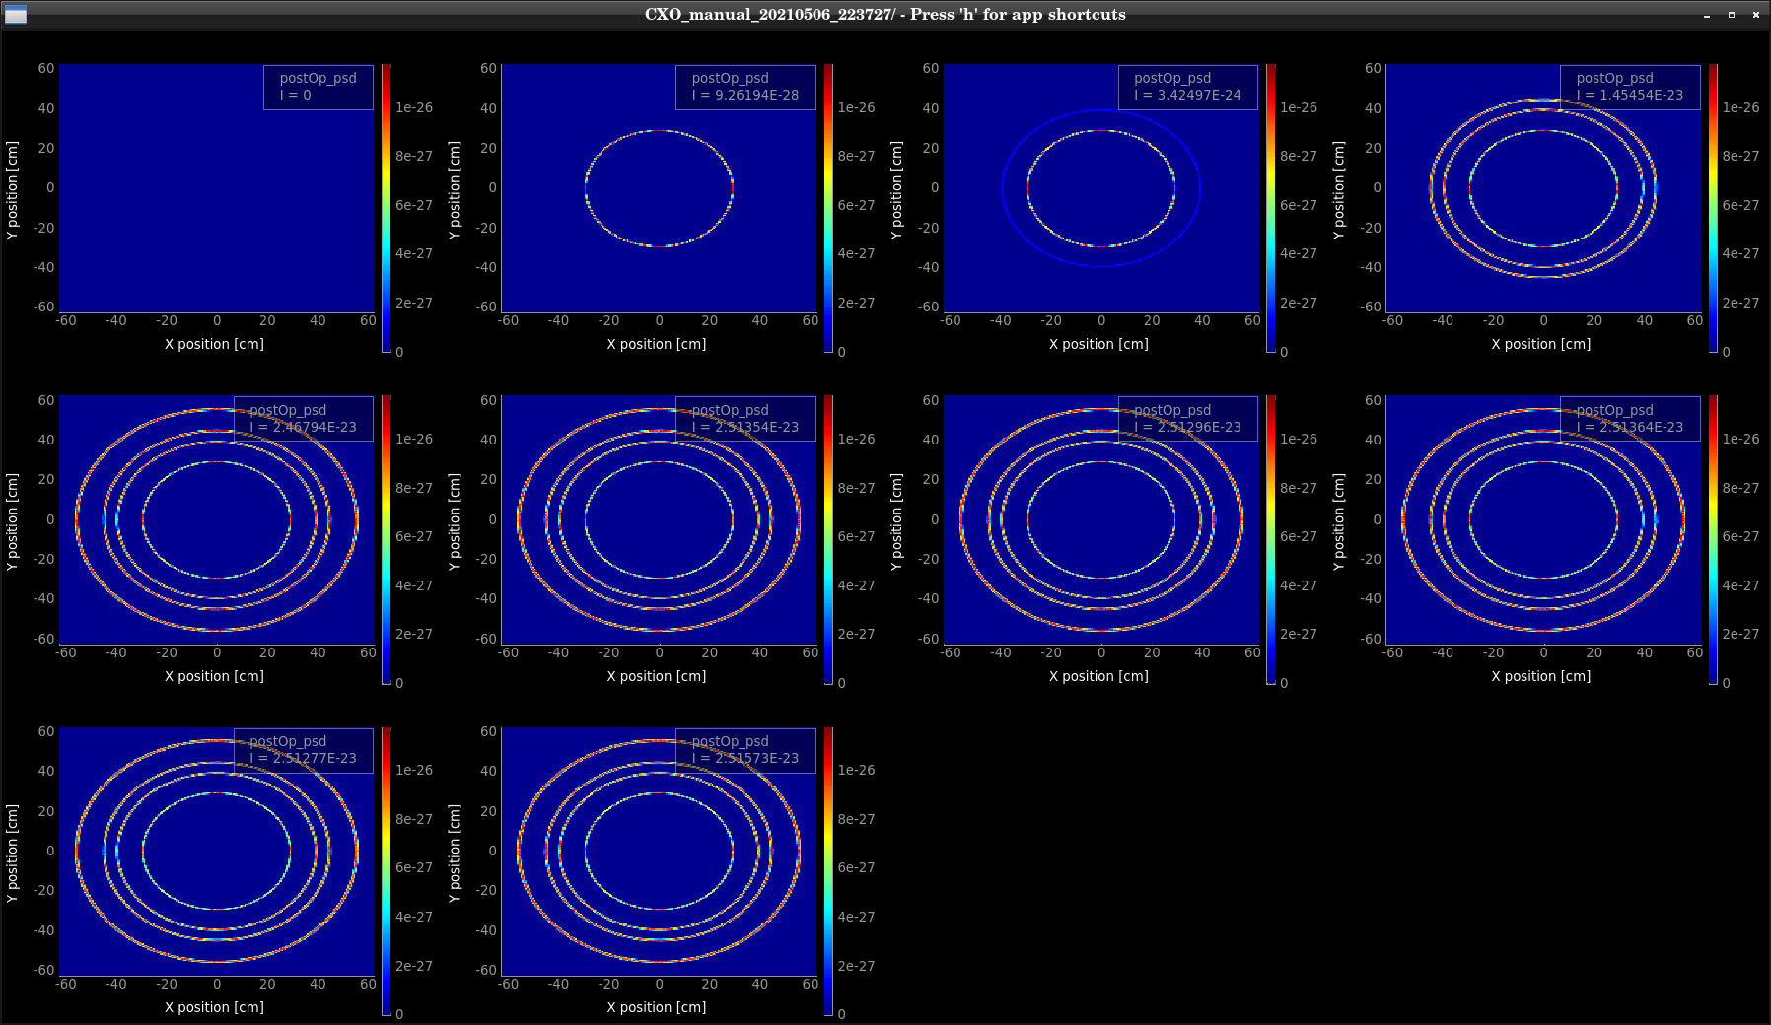
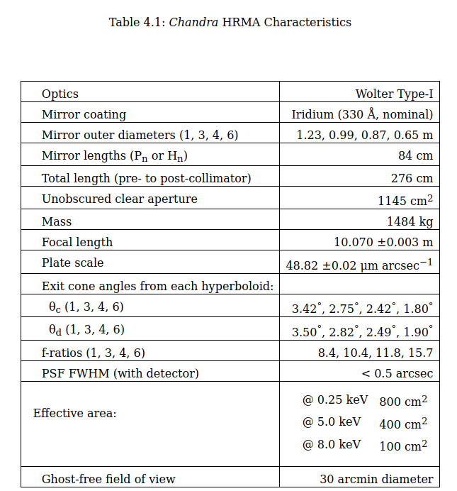
Port to McStas for neutron use? CXO
Scan for m=1, lambda=1-10Å scan, standard neutron guide reflectivity function

Slide 10
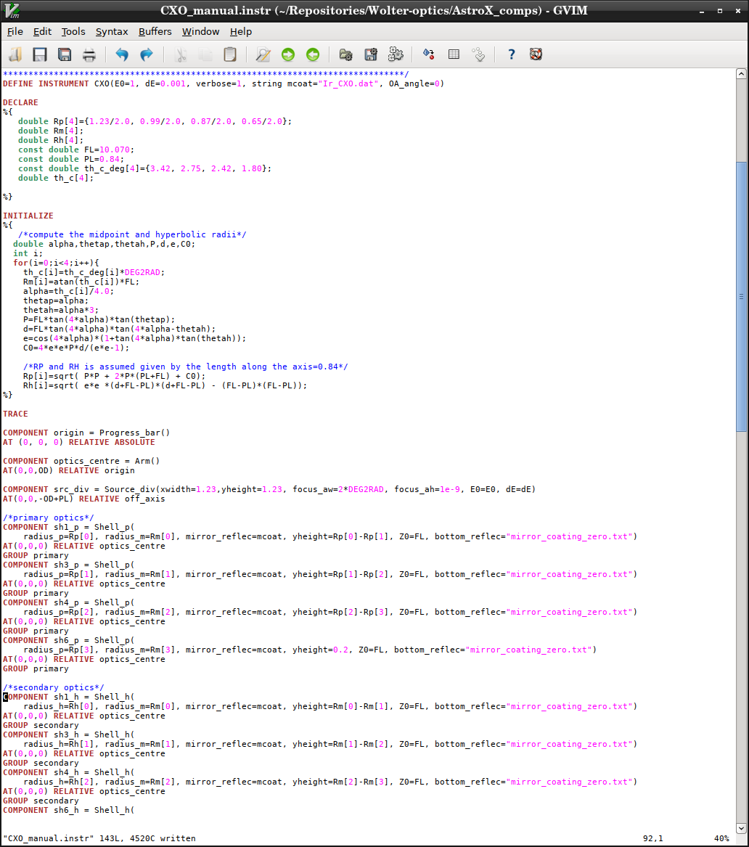
The Code

Slide 11
ConicTracer from MIT
Erik B. Knudsen and Peter Willendrup - with input from Boris Khaykovic, MIT

Slide 12
Historical stuff
Code was never officially part of McStas, only “distributed” on a per-request basis (Boris never asked us to include it officially, solely out of concerns wrt. ease of use etc.)
Developed by Boris with helped of a series of MIT students
In ~2010 Peter helped port the code from McStas 1.x to 2.x
The code in the ”standard” zip-file included no chosen geometry, i.e. not easy to get started for a new geometry

Slide 13
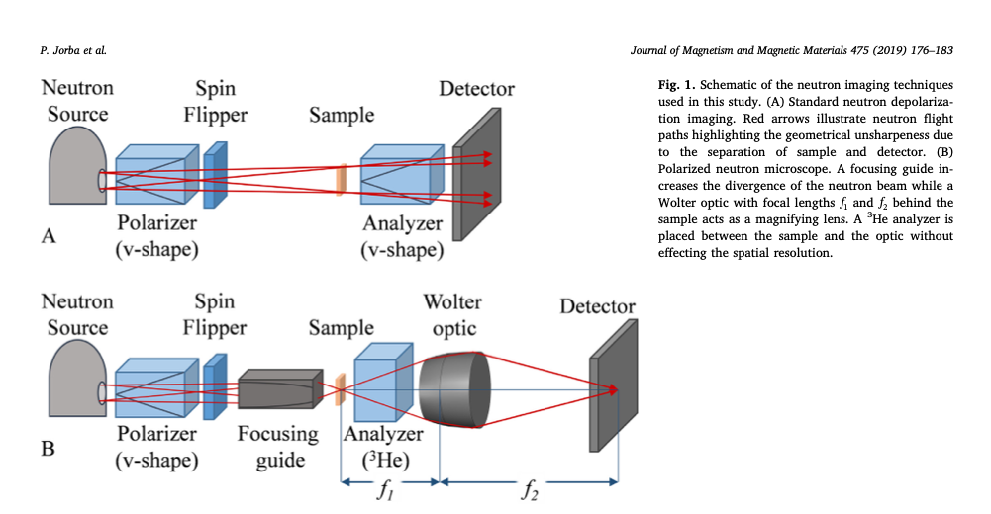

Communication with Boris K 2021 (this week!)
A bit of email-ping-pong
resulted in access to a more digestible set of files with a relevant geometry.
“The code implements our NIH mirrors (it needs the conic tracer library), a combination of Ellipsoid and Hyperboloid, 3.2 m focus-to-focus distance, magnification 4. I attached the paper where polarized imaging was demonstrated. Figs 1 and 2 are particularly relevant for this discussion.”

Slide 14
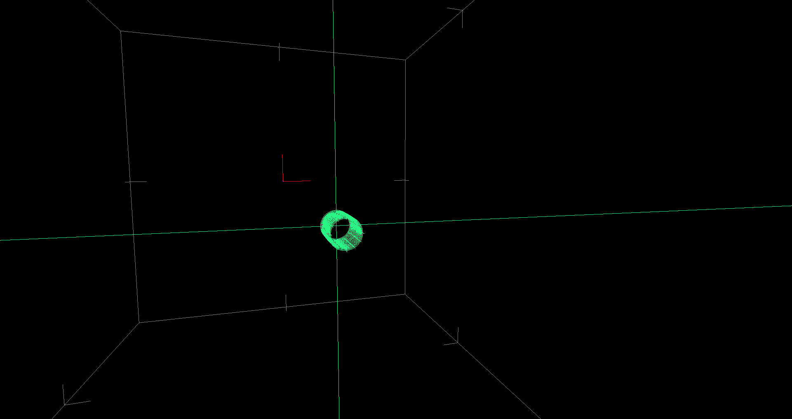
NIH mirror model from Boris Khaykovic

Slide 15
Structure of the W1 instrument
Component origin AT (0,0,0) 0 m from origin
Component source AT (0,0,-0.101) 0.101 m from origin
Component source_slit AT (0,0,-0.1) 0.102 m from origin
Component FocalSource AT (0,0,0) 0.202 m from origin
Component source_dir_monitor AT (0,0,0) 0.202 m from origin
Component conics AT (0,0,0.5) 0.702 m from origin
Component f1_monitor AT (0,0,3.2) 3.402 m from origin
Component PSD_FocalSpot AT (0,0,3.2) 3.402 m from origin

Slide 16
Structure of the code
Instrument file: w1.instr
Adapted source: Source_div_round.comp
Conics component: Conics.comp, defines geometry, calls
w1_conics.h – with specific functions for EH and HE mirror variants, relies on
conic.h – with the underlying mathematical framework
(Includes a main() from an older stand-alone code, significant “duplication” of vector- and particle-code which can already be found elsewhere in McStas)
To redefine geometry one should edit the Conics.comp code, not a very McStas-oriented solution :-)

Slide 17
cdcdcd
Instrument and comp have ~ fixed geometry
Component only serves as coupling to the conic.h functions

Slide 18
Hard-coded mirror-geometry in Conics.comp

Slide 19
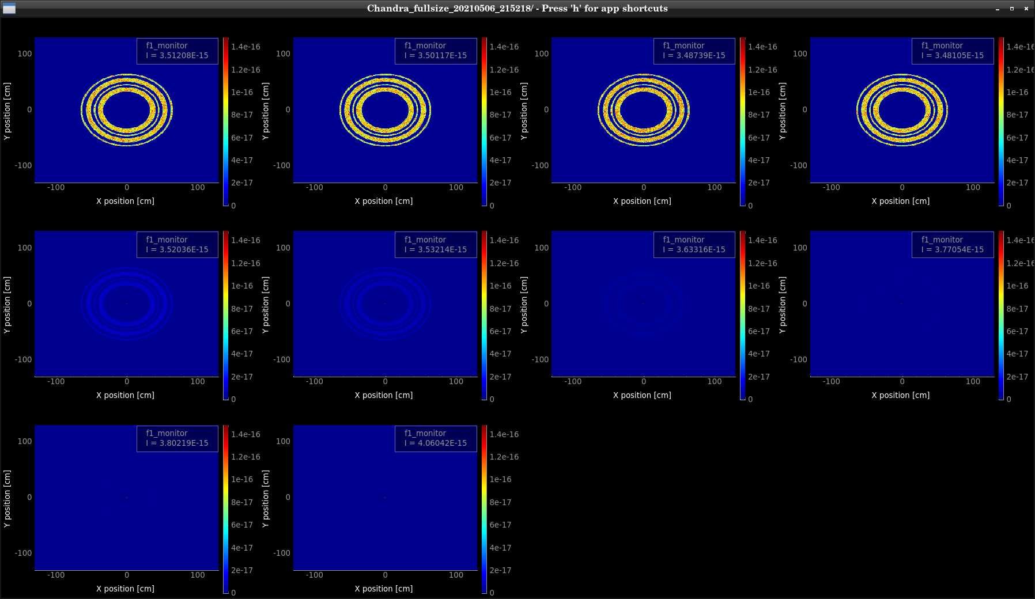
Analogous for CXO w. conic tracer
Scan for m=1, lambda=1-10Å scan, standard neutron guide reflectivity function – no waviness but transmission through mirrors

Slide 20
What next?
Clean out ”dead” and duplicated code
Try to use as much as possible from McStas 2.x runtime
Will serve as ”benchmark” code
Work together on this basis with Boris and new student coming in
Include a few versions of Conics.comp named with EH HE etc. geometry -> all using standard lib of Wolter geometries
Do lots of comparisons with McXtrace-derived soltion
Migrate to use of McStas 3 _particle struct -> further simplification

